Slide 1
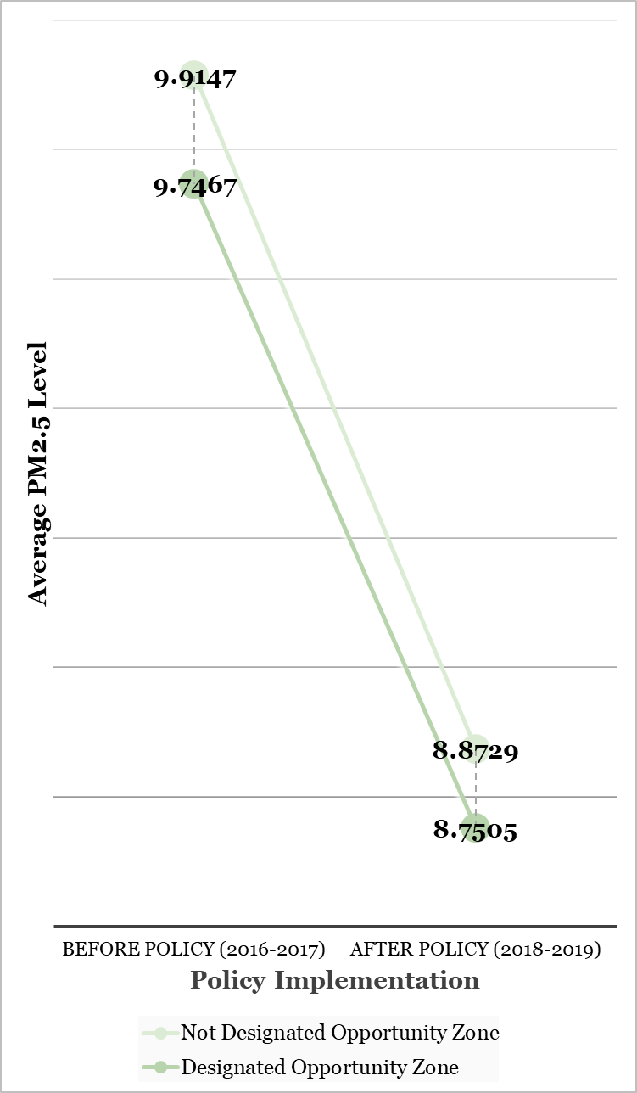
Two Sides of Justice: Balancing between
Environmental and Economic Justice for Sustainable Communities
Danielle Fonsing | Zoe Pettigrew | Heewon Lee
Askew School of Public Administration and Policy, Florida State University
Introduction
In the United States, governments from all levels have created policies in efforts to balance the three pillars of sustainability: economic development, environmental protection, and social equity for sustainable development (Opp & Saunders, 2013). However, these policies often unsuccessfully take a comprehensive approach and address all of these pillars (Opp & Saunders, 2013).
This research establishes the compatibility of economic and environmental justice in resurging urban environments through the examination of zoning programs.
Specifically, the zoning programs for economic development and how they affect environmental and health outcomes are studied along with whether the program disproportionately affects marginalized communities.
Poor geographic targeting by state governments has led to current gentrified areas to be selected for zoning programs over areas clearly in distress (Gelfond & Looney, 2018). This reduced the impact of the program, and its benefits for poor residents (Gelfond & Looney, 2018).
Compared to non-designated areas, economic development zoning has negatively impacted low income areas’ environmental outcomes.
Results of this research will influence policymakers and local governments to cooperate with federal agencies in varying policy areas to reach environmental, social, and economic goals.
Results
The term particulate matter 2.5 (PM2.5) refers to particles or droplets in the air that are 2.5 microns or less in width. Higher levels of these air pollutants can reduce visibility, cause the air to appear hazy, and are a concern for people’s health. Positive values indicate higher levels of PM2.5 in the air while negative values signify lower levels of PM2.5 in the air.
Conclusion
Environmental justice should be promoted and prioritized since our findings indicate that areas with greater marginalized and low income populations experience poorer air quality with more particulate matter 2.5.
Furthermore, the OZ program has a negative impact in lowering particulate matter and has a lower improvement rate in air quality as compared to areas that are not designated by these programs.
To achieve improved air quality in areas with low income populations, marginalized populations, and OZ designations, economic development programs should be reformed to emphasize consequences on environmental justice.
Policymakers should pay attention to environmental justice following economic development programs.
It is important for them to consider marginalized communities who do not have the political power and cannot voice their interests in policy decision making.
Cooperation among policymakers and the addition of environmental justice in the EPA’s decision process are necessary to attain economic, social, and environmental goals equitably.
Figure 2: Impact of Air Quality on Opportunity Zone Designation
Variables | PM2.5 Level In Air
Opportunity Zone | -0.168*** (0.013)
Before and After Policy Implementation | -1.042*** (0.008)
Opportunity Zone Before and After | 0.056*** (0.017)
Total Population | 0.000*** (0.000)
Low Income Individuals Percent | 0.317*** (0.022)
Ratio of White Population | -0.988*** (0.037)
Ratio of Black Population | 0.727*** (0.038)
Governor: Republican Compared to Democrat | 0.510*** (0.007)
Number of Observations | 286,293
R-Squared | 0.306
Figure 1: Opportunity Zone Designation
and Outcome Model
Economic Development
References
Bureau, U. S. C. (2021, October 8). State & Local Government Finance Historical Datasets and Tables. Census.gov. Retrieved February 10, 2022, from https://www.census.gov/programs-surveys/gov-finances/data/datasets.All.List_1883146942.html
Environmental Protection Agency. (2021, December). Environmental Justice. EPA. Retrieved February 10, 2022, from https://www.epa.gov/environmentaljustice
Dobbin, K. B., & Lubell, M. (2019, December 12). Collaborative Governance and Environmental Justice: Disadvantaged Community Representation in California Sustainable Groundwater Management. Policy Studies Journal, 49(2), 562–590. https://doi.org/10.1111/psj.12375
Gelfond, H., & Looney, A. (2018, October). Looney opportunity zones - brookings institution. Learning from Opportunity Zones: How to improve place-based policies. Retrieved February 10, 2022, from https://www.brookings.edu/wp-content/uploads/2018/10/Looney_Opportunity-Zones_final.pdf
National Council of State Housing Agencies. (2021, December 21). Opportunity Zone Fund Directory. NCSHA. Retrieved February 10, 2022, from https://www.ncsha.org/resource/opportunity-zone-fund-directory/
Opp, S. M., & Saunders, K. L. (2013, January 2). Pillar Talk. Urban Affairs Review, 49(5). https://doi.org/10.1177/1078087412469344
Marginalized Communities
Environmental Protection
Urban Revitalization Program
Governor Opportunity Zone Designation
Social Equity
Non Marginalized Communities
Economic Development
Environmental Protection
Figure 3: DID Analysis Results of OZ Designation on Air Quality
Discussion
Our hypothesis was not rejected by the results.
Designated OZ areas with low income and large minority populations were found to have worse air quality.
The results indicate that economic development zoning has negative effects on the low income areas’ environmental outcomes, compared to the non designated areas.
The significance of this indication demonstrates that opportunity zone designation is not followed by environmental justice for marginalized communities.
While there was a decrease in particulate matter (PM2.5) in both designated and non-designated tracts after policy implementation, it is important to note that the PM2.5 for designated areas increases 0.05561 more than it would have without designation.
Since the research was observational, the generalizability of the results may be limited.
This is because there may be confounding variables that could have had effects on certain areas and their air quality.
However, our results are still valid for the purpose of answering the research question.
The analysis results also suggest that, when looking at state level policies, republican states have worse air quality than democratic states.
This can help provide a clearer understanding of certain policy implications and the effects they have on a communities environmental conditions.
Social Equity
Methods
First, data was collected for research from all 50 states.
This includes data from 2016 to 2019 on state spending, governor characteristics, Opportunity Zone designation, air quality, and state race ratios from low income census tracts.
This data was sourced from federal and state databases, NCSHA Opportunity Zone Fund Directory, Environmental Protection Agency EJscreen, and United States Census Bureau State and Local Government Historical Datasets and Tables (Bureau, 2021; Environmental Protection Agency, 2021; National Council of State Housing Agencies, 2021).
Using this data, a nationwide dataset was constructed and captures information on marginalized community development programs, environmental consequences at the community-level, Opportunity Zone designation criteria, and state demographic information from 2016 to 2019.
Lastly, the difference-in-differences method was applied to empirically test the hypothesis.
Acknowledgement
This research is funded by the Undergraduate Research Opportunity Program grant. We would like to give a special thanks to our research mentor, Heewon Lee, and our Undergraduate Research Opportunity Program Leaders, Marie Sintulaire and Geanny Arboleda, for guiding us through this research project.

